Slide 1
CS 4530: Fundamentals of Software Engineering Module 06: Concurrency Patterns in Typescript
Adeel Bhutta, Mitch Wand
Khoury College of Computer Sciences
© 2023,-2025 Released under the CC BY-SA license

Slide 2
Asynchronous Programming: we've been teaching it all wrong (again)
This slide is me explaining what's going on in this deck; it is not for distribution to students.
I finally that trying to explain async programming in terms of promises is like explaining typescript in terms of assembly language: it's just the *wrong level*
Among other things, it fails to emphasize that you can determine the points at which your execution can be interrupted is *statically determinable".
These slides *start* by explaining what the uninterruptible segments of your program are.
So we take "run to completion" as a fundamental concept (explaining that it's a misnomer), and go on from there.
See if you think this could work!!

Slide 3
Learning Goals for this Lesson
At the end of this lesson, you should be prepared to:
Explain the difference between JS run-to-completion semantics and interrupt-based semantics.
Given a simple program using async/await, work out the order in which the statements in the program will run.
Write simple programs that create and manage promises using async/await
Write simple programs to mask latency with concurrency by using non-blocking IO and Promise.all in TypeScript.
Notes:
<read slide>

Slide 4
Your app probably spends most of its time waiting
Consider: a 1Ghz CPU executes an instruction every 1 ns
Almost anything else takes approximately forever
Want to utilize this “wasted” time by doing something else
Processing data
Communicating with remote hosts
Timers that countdown while our app is running
Echoing user input
CPU 1
Main Memory
150,000ns (just to read 4KB)
SSD
thread0()
CPU 1 Cache
7ns
100ns
10,000,000ns (just to seek!)
Magnetic HD
~100,000,000ns
Earth to moon: ~16,000,000 inches
Remote Computer (Internet in between)
4
Notes:
First principles: why do we need concurrency?
Mostly I/O. We are spoiled today with huge amounts of RAM, but there are still occasions when you need to read or write something to/from disk, or to/from network.
This diagram shows roughly the overhead of different kinds of I/O, in nanoseconds. Cutting-edge hardware architectures and OS designs aim to reduce these delays, but the rough order of magnitudes still stand.
If we are “computing” things (running instructions on the CPU), on a 1Ghz CPU, that’s nice and round, so you get 1 instruction executed per nano-second. You could run 150k instructions in time to read 4KB from SSD, 10m instructions in time to get the read head on your spinning magnetic HD into place to read something, or 100m instructions in time to receive a packet over internet.
So, it is desirable to be able to keep doing things while we are waiting for I/O, and not stop the world. Another way to put this, is that we would like to mask this latency to do such slow operations with concurrency: do something else while these I/O operations are happening.

Slide 5
We achieve this goal using two techniques: 1. cooperative multiprocessing 2. non-blocking IO

Slide 6
Most OS's use pre-emptive multiprocessing
OS manages multiprocessing with multiple threads of execution
Processes may be interrupted at unpredictable times
Inter-process communication by shared memory
Data races abound
Really, really hard to get right: need critical sections, semaphores, monitors (all that stuff you learned about in op. sys.)
Notes:
In many programming languages, like Java or C, you can have asynchronous computation with threads.
You might be familiar with this programming model. As it turns out, the “inter-process communication by shared memory” part is extremely hard to get right, and almost impossible to prove correct
This is not how JS or TS does asynchronous computation.

Slide 7
Javascript/Typescript uses cooperative multiprocessing
In cooperative multiprocessing, only one process is executed at a time.
Each process pauses when it is convenient to allow other processes to make progress.
To make this practical (and avoid cheating!), we need a programming model that encourages this behavior
Notes:
In cooperative multiprocessing, each thread decides when it should yield to let other threads execute. For the purposes of this lecture, we will use the terms 'promise' and 'computation' interchangeably (MAYBE??)

Slide 8
async/await: a programming model for cooperative multiprocessing
In async/await, the program is organized into a set of "async functions".
An async function is like an ordinary function, except that it will pause at two well-defined points in its execution.
When one program pauses, the runtime can choose to resume executing any process that is ready to run.

Slide 9
A typical async function
async function someFunction(i: number) {
const j = i + 1;
// ...
const k = await someOtherAsyncFunction(j);
// ...
const m = k + 100
return m;
}

Slide 10
An async function can pause in exactly two places
async function someFunction(i: number) {
const j = i + 1;
// ...
const k = await someOtherAsyncFunction(j);
// ...
const m = k + 100
return m;
}
HERE
AND HERE
Notes:
An async function yields or pauses in exactly two places in its code.
When someFunction yields at the first location, it informs the runtime that someOtherAsyncFunction(j) is ready to run, and that someFunction will be ready to resume its executing only when someOtherAsyncFunction(j) returns a value. The runtime can then switch to any process that is ready. That might be the call to someOtherAsync function, but it might be something else.
When someFunction yields at the second location, it informs the runtime that it is ready to return to its caller, and it gives the runtime permission to switch to any process that is ready. It might be the caller of someFunction, or it might be something else.

Slide 11
Those are the ONLY places an async function can pause.
async function someFunction(i: number) {
const j = i + 1;
// ...
const k = await someOtherAsyncFunction(j);
// ...
const m = k + 100
return m;
}
Never in here
Or in here
Notes:
By disallowing interrupts everywhere but at the pause points, we avoid almost all of the data races you may have learned about in your operating systems class. Each grey box is a critical section, and your program consists of a set of critical sections. Each grey box is uninterruptible!!

Slide 12
Terminology: promises and run-to-completion
The units of work between two pause points is called a "promise"
The pattern we've just talked about is called "run-to-completion" semantics, because a pause point corresponds exactly to the end of one of these units of work
You can do lots of different things with promises.
Let's look some typical patterns.

Slide 13

Programming with async/await
When you program, you will typically start with some typescript API procedure that is an async.
These are typically things like I/O or http calls.
Then you will build bigger asyncs.
Let's show some examples.
This Photo by Unknown Author is licensed under CC BY-NC
Notes:
We've talked about the behavior of promises. But how do we program with them?

Slide 14
Example:
src/XXXXX/oneRequest.ts
// fakeRequest(n) is an async that waits for 1 second and then
// resolves with the number n+10
import { fakeRequest } from "./fakeRequest";
import { timeIt } from "./timeIt";
async function main() {
console.log('main started');
const request = 32
const res = await fakeRequest(request);
console.log(`fakeRequest(${request}) returned: ${res}`);
console.log('main done');
}
timeIt(main)
$ npx ts-node oneRequest.ts
main started
fakeRequest received request: 32
time passes....
fakeRequest(32) returned: 42
main done
1015.98 msec
Notes:
Review the code. main() waits for the request to return, and then continues.

Slide 15
Use Promise.all to execute several requests concurrently
async function main() {
console.log('starting main');
const promises = [fakeRequest(1),
fakeRequest(2),
fakeRequest(3)];
const results = await Promise.all(promises);
console.log('results:', results);
console.log('main done');
}
timeIt(main)
$ npx ts-node threeRequestsConcurrently.ts
starting main
fakeRequest received request: 1
time passes....
fakeRequest received request: 2
time passes....
fakeRequest received request: 3
time passes....
results: [ 11, 12, 13 ]
main done
1018.81 msec

Slide 16
If you add awaits, the requests will be processed sequentially
$ npx ts-node threeRequestsSequentially.ts
starting main
fakeRequest received request: 1
time passes....
fakeRequest(1) returned: 11
fakeRequest received request: 2
time passes....
fakeRequest(2) returned: 12
fakeRequest received request: 3
time passes....
fakeRequest(3) returned: 13
main done
3024.03 msec
async function main() {
console.log('starting main');
const res1 = await fakeRequest(1);
console.log(`fakeRequest(1) returned: ${res1}`);
const res2 = await fakeRequest(2);
console.log(`fakeRequest(2) returned: ${res2}`);
const res3 = await fakeRequest(2);
console.log(`fakeRequest(2) returned: ${res3}`);
console.log('main done');
}
timeIt(main)
src/XXXXX/threeRequestsSequentially.ts
Notes:
Review the code. main() waits for the request to return, and then continues.

Slide 17
…but it would be much slower
$ npx ts-node timeComparison.ts
After 100 runs of length 10
makeRequestsConcurrently: min = 23 avg = 34 max = 190 milliseconds
makeRequestsSerially : min = 210 avg = 237 max = 812 milliseconds
Need to redo with this semester's examples
Notes:
We should leverage concurrency whenever possible.
(Time is average of 100 runs on Prof. Wand’s Lenovo X1)

Slide 18
Why is that? Visualizing Promise.all
“Don’t make another request until you got the last response back”
Sequential (await)
237 msec
send
wait
receive
send
wait
receive
send
wait
receive
“Make all of the requests now, then wait for all of the responses”
Concurrent (Promise.all)
34 msec
send
wait
receive
send
wait
receive
send
wait
receive
Notes:
In both cases, there is at most one active promise (in green) at any time! But the concurrent version "masks latency with concurrency", as we said way back on slide 1.

Slide 19
Requests can also be chained
async function main() {
console.log('main started');
const request1 = 32
const res1 = await fakeRequest(request1);
console.log(`fakeRequest(${request1}) returned: ${res1}`);
const res2 = await fakeRequest(res1);
console.log(`fakeRequest(${res1})returned: ${res2}`);
const res3 = await fakeRequest(res2);
console.log(`fakeRequest(${res2})returned: ${res3}`);
console.log([request1, res1, res2, res3]);
console.log('main done');
}
$ npx ts-node threeRequestsChained.ts
main started
fakeRequest received request: 32
time passes....
fakeRequest(32) returned: 42
fakeRequest received request: 42
time passes....
fakeRequest(42)returned: 52
fakeRequest received request: 52
time passes....
fakeRequest(52)returned: 62
[ 32, 42, 52, 62 ]
main done
3080.99 msec
Notes:
In the examples so far, the arguments to the requests were independent of each other. But there's no reason they have to be independent (except for Promise.all). You can make them any way you need to.

Slide 20
Recover from errors with try/catch
// a request that may fail
async function maybeFailingRequest(req: number): Promise<number> {
const res = await fakeRequest(req);
if (res < 0) {
throw new Error(`Request ${req} failed because response ${res} < 0`);
} else {
return res;
}
}
Notes:
asyncs play nicely with try/catch. Here we've tweaked fakeRequest so that it will sometimes throw an error, and here's a wrapper that recovers from those errors (by returning 0).

Slide 21
try/catch, continued
async function main() {
console.log('main started');
const req1 = -32
let res: number;
try {
res = await maybeFailingRequest(req1);
console.log(`fakeRequest(${req1}) returned: ${res}`);
} catch (err) {
console.error(`Error occurred for request ${req1}`);
res = 0
}
console.log('main done with res =', res);
}
timeIt(main);
$ npx ts-node tryCatchExample.ts
main started
fakeRequest received request: -32
time passes....
Error occurred for request -32
main done with res = 0
1007.52 msec

Slide 22
Pattern for testing an async function
test('fakeRequest should return its argument + 10', async () => {
expect.assertions(1)
await expect(fakeRequest(33)).resolves.toEqual(43)
})
// this will succeed, because it does not await the promise
test('bogus test', async () => {
// expect.assertions(1)
expect(fakeRequest(33)).resolves.toEqual(99)
})
src/XXX/jest-example.test.ts
Notes:
Let's change the subject. How do you test an async function? To test an async function, make the second argument to ‘test’ an async function. This will make ‘expect’ itself an async function, so you will need to ‘await’ its result. Calling expect.assertions checks to make sure that your test properly awaited the the result of the request.
This example is easy, since we are only sending some data to a public web site. If we wanted to do something that might have a global effect (e.g. a transcript database), we'd have to do some mocking. Alas, that is too much for this lecture ☺.
Here, echo is an async function, so it returns a promise, which should eventually return a string (here “33”) to the async function that called it (here, the expect). So here we are saying that we expect echo(33) to return a promise that will eventually resolve to “33”.
Note the await on the next to last line. If you leave that out, the async function in the test will succeed immediately, without waiting for the expect to run. The expect.assertions (in blue) tells Jest that the test should run exactly 1 test, so that will make the test fail if you leave out the await.

Slide 23
AntiPattern 1: unawaited promise
src/XXXXX/oneRequestNoAwait.ts
// fakeRequest(n) is an async that waits for 1 second and then
// resolves with the number n+10
import { fakeRequest } from "./fakeRequest";
import { timeIt } from "./timeIt";
async function main() {
console.log('main started');
const request = 32
const res = fakeRequest(request);
console.log(`fakeRequest(${request}) returned: ${res}`);
console.log('main done');
}
timeIt(main)
$ npx ts-node oneRequestNoAwait.ts
main started
fakeRequest(32) returned: [object Promise]
main done
2.64 msec
fakeRequest received request: 32
time passes....
Notes:
Review the code.

Slide 24
What just happened?
$ npx ts-node oneRequestNoAwait.ts
main started
fakeRequest(32) returned: [object Promise]
main done
2.64 msec
fakeRequest received request: 32
time passes....
main() called fakeRequest(32).
fakeRequest(32) created a unit of work (a Promise), and told the runtime to run it sometime or other.
Normally, we wouldn't see the actual value returned by fakeRequest(32), because we'd just wait for the unit of work to run before proceeding.
But here, we didn't wait-- we just took the value returned by fakeRequest(32)-- the Promise-- and printed it.
We finished our current unit of work, printing "main done", which informed the runtime that we were done.
The runtime then looked around for another unit of work to do. In this case, it found the unit of work created by fakeRequest(32), and ran it, printing the last two lines
Notes:
OK, this is complicated (which is why it's an antipattern). Here's what happened:
main() called fakeRequest(32).
fakeRequest(32) created a unit of work (a Promise), and told the runtime to run it sometime or other.
Normally, we wouldn't see the actual value returned by fakeRequest(32), because we'd just wait for the unit of work to run before proceeding.
But here, we didn't wait-- we just took the value returned by fakeRequest(32)-- the Promise-- and printed it.
We finished our current unit of work, printing "main done", which informed the runtime that we were done.
The runtime then looked around for another unit of work to do. In this case, it found the unit of work created by fakeRequest(32), and ran it, printing the last two lines

Slide 25
Wow! That was complicated!
We try to make our code easy to understand.
That's why it's an antipattern.
Luckily, in real code we don't need to do this very often
is complicated (which is why it's an antipattern). Here's what happened:

Slide 26
AntiPattern1a: async with no await
async function main() {
console.log('main started');
const request = 32
const res = fakeRequest(request);
console.log(`fakeRequest(${request}) returned: ${res}`);
console.log('main done');
}
Notes:
This example also illustrates another antiPattern: an async function with no await. As it turns out, an async function with no await returns a promise to its returned value-- in this case, a promise that just returns void. If your function doesn't call any async function, then it shouldn't be an async. If your function calls one or asyncs, then it should await them (either with await or await(Promise.all(…)) .)

Slide 27
AntiPattern 2: Side-effect before await
async function f() {
console.log('f started');
await g();
console.log('f done');
}
async function g() {
console.log('g started');
const res = await fakeRequest(32);
console.log(`fakeRequest(32) returned: ${res}`);
}
These two are actually part of the *same* critical section
Notes:
Before, we marked the critical sections in a single async function. When we consider two or more asyncs, the story is a little more complicated-- the two salmon-colored sections actually form a single critical section, so the 'f started' will *always* be followed immediately by the 'g started'. (And if there was a side-effect at the start of fakeRequest, that would similarly follow immediately after the 'g started'. But there isn't ☺ ) .
The 'g started' exposes this subtlety-- if it wasn't there, you'd never be able to tell the difference. So don't do that. Make sure that nothing you do before the first await in your async causes a visible side-effect (e.g. a console.log), unless you really want to track what's going on at this level of detail.

Slide 28
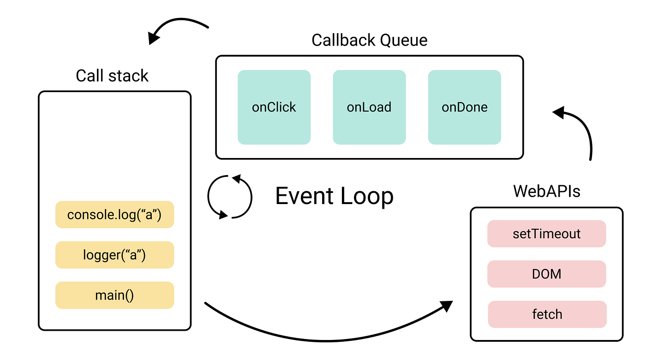
How does JS Engine make this happen?
One Event Loop means that we have single thread of execution
WebAPI are used for asynchronous tasks
Queues are used for “await”-ing tasks
When call stack gets empty, event loop picks up tasks from Callback Queue
Notes:
<read slide>.
- JS Engine includes a {single} call stack that keeps track of each function that it is being executed
- Asynchronous (heavy) tasks are outsourced to WebAPI. When those are completed, they are placed in a callback queue.
- Event loop picks up “awaiting” {completed} tasks from queue when call stack is empty (i.e., when it is done with everything it was working on – think run to completion) and processes them in the order they were added to queue (i.e., they were completed by WebAPI)

Slide 29
We achieve this goal using two techniques: 1. cooperative multiprocessing 2. non-blocking IO
But where does the non-blocking IO come from?
Notes:
That concludes our tour of cooperative multiprocessing.
But where does the non-blocking IO come from?

Slide 30
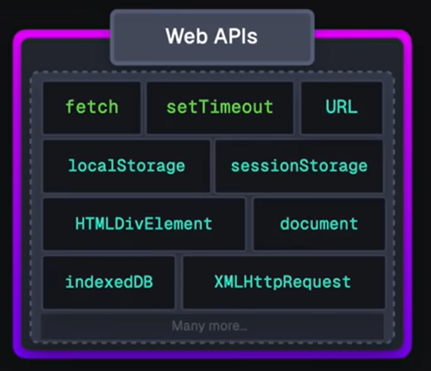
Answer: JS/TS has some primitives for starting a non-blocking computation
These are things like http requests, I/O operations, or timers.
Each of these returns a promise that you can await. The promise runs while it is pending, and produces the response from the http request, or the contents of the file, etc.
You will hardly ever call one of these primitives yourself; usually they are wrapped in a convenient procedure, e.g., we write
axios.get('https://rest-example.covey.town’)
to make an http request, or
fs.readFile(filename)
to read the contents of a file.
Notes:
This is what we said back on the slide with the stork, where we said "Some typescript libraries have API procedures that return promises"

Slide 31
Pattern for starting a concurrent computation using non-blocking I/O
export async function makeRequest(requestNumber:number) {
console.log(`starting makeRequest(${requestNumber})`);
const response = await axios.get('https://rest-example.covey.town');
console.log('request:', requestNumber, '\nresponse:', response.data);
}
The first console.log is printed
The http request is sent, using non-blocking i/o
A promise is created to run the second console.log after the axios.get returns
The makeRequest() returns to its caller.
Notes:
It is important to note that you can call makeRequest but it will be awaiting a future response. That promise was returned immediately back to the caller (whichever promise called the makeRequest) and that the caller’s thread continues on while makeRequest is waiting for a response, just as in our previous examples.

Slide 32
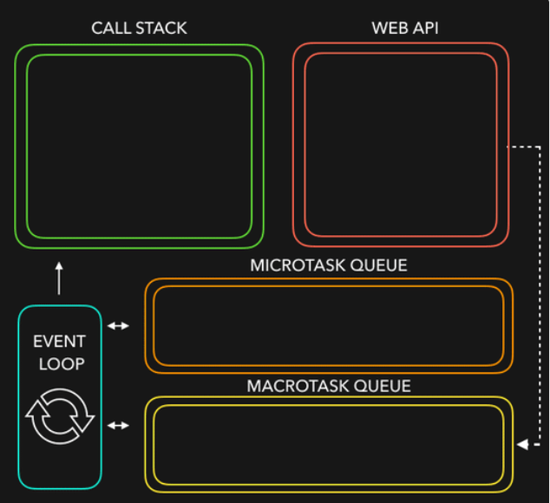
Let’s put it all together
JS/TS has single event loop
We outsource most of the non-blocking IO work (to WebAPIs) for asynchronous work
Upon completion, they are placed in queues (Microtask queue has priority over Macrotask queue)
Event loop picks them up from queue when call stack is empty!
Notes:
Javascript is a single threaded language. This means it has one call stack and one memory heap. It uses WebAPI to work asynchronously.
How do we get asynchronous code with Javascript then?
Well, we can thank the Javascript engine (V8, Spidermonkey, JavaScriptCore, etc...) for that, which has Web API that handle these tasks in the background. The call stack recognizes functions of the Web API and hands them off to be handled by the browser. Once those tasks are finished by the browser, they return and are pushed into a queue (callbacks go in Macrotask queue and promises go into microtask queue)
Then they are picked up by the event loop one by one and added onto the call stack.
Try this http://latentflip.com/loupe

Slide 33
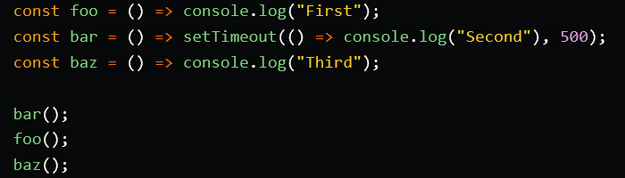
Here is a quick demo for you
Courtesy of https://dev.to/lydiahallie/javascript-visualized-event-loop-3dif
Notes:
Courtesy of https://dev.to/lydiahallie/javascript-visualized-event-loop-3dif

Slide 34
Everything after here is old
We'll consider what changes should be made (if any!)
I don't like being dependent on a transcript server that we don't control.

Slide 35
General Rules for Writing Asynchronous Code
You can’t return a value from a promise to an ordinary procedure.
You can only send the value to another promise that is awaiting it.
Call async procedures only from other async functions or from the top level.
Break up any long-running computation into async/await segments so other processes will have a chance to run.
Leverage concurrency when possible
Use promise.all if you need to wait for multiple promises to return.
Check for errors with try/catch

Slide 36
An Example Task Using the Transcript Server
Given an array of StudentIDs:
Request each student’s transcript, and save it to disk so that we have a copy, and calculate its size
Once all of the pages are downloaded and saved, print out the total size of all of the files that were saved

Slide 37
Generating a promise for each student
async function asyncGetStudentData(studentID: number) {
const returnValue =
await axios.get(`https://rest-example.covey.town/transcripts/${studentID}`)
return returnValue
}
async function asyncProcessStudent(studentID: number) : Promise<number> {
// wait to get the student data
const response = await asyncGetStudentData(studentID)
// asynchronously write the file
await fsPromises.writeFile(
dataFileName(studentID),
JSON.stringify(response.data))
// last, extract its size
const stats = await fsPromises.stat(dataFileName(studentID))
const size : number = stats.size
return size
}
Calling await here also gives other processes a chance to run.
src/transcripts/simple.ts
Notes:
Each await is associated with a data dependency. DISCUSS: what is the data dependency for the second 'await'?

Slide 38
Running the student processes concurrently
async function runClientAsync(studentIDs:number[]) {
console.log(`Generating Promises for ${studentIDs}`);
const studentPromises =
studentIDs.map(studentID => asyncProcessStudent(studentID)) ;
console.log('Promises Created!');
console.log('Satisfying Promises Concurrently')
const sizes = await Promise.all(studentPromises);
console.log(sizes)
const totalSize = sum(sizes)
console.log(`Finished calculating size: ${totalSize}`);
console.log('Done');
}
Map-promises pattern: take a list of elements and generate a list of promises, one per element
src/transcripts/simple.ts

Slide 39
Output
runClientAsync([411,412,423])
$ npx ts-node simple.ts
Generating Promises for 411,412,423
Promises Created!
Satisfying Promises Concurrently
[ 151, 92, 145 ]
Finished calculating size: 388
Done

Slide 40
But what if there’s an error?
runClientAsync([411,412,87065,423,23044])
$ npx ts-node transcripts/simple.ts
Generating Promises for 411,412,87065,423,23044
Promises Created!
Satisfying Promises Concurrently
<blah blah blah>\node_modules\axios\lib\core\createError.js:16
var error = new Error(message);
^
Error: Request failed with status code 404
Oops!
Notes:
23044 is not the ID of any student

Slide 41
Need to catch the error
type StudentData = {isOK: boolean, id: number, payload?: any }
/** asynchronously retrieves student data, */
async function asyncGetStudentData(studentID: number): Promise<StudentData> {
try {
const returnValue =
await axios.get(`https://rest-example.covey.town/transcripts/${studentID}`)
return { isOK: true, id: studentID, payload: returnValue }
} catch (e) {
return { isOK: false, id: studentID }
}
}
Catch the error and transmit it in a form the rest of the caller can handle.
src/transcripts/handle-errors.ts

Slide 42
And recover from the error…
async function asyncProcessStudent(studentID: number): Promise<number> {
// wait to get the student data
const response = await asyncGetStudentData(studentID)
if (!(response.isOK)) {
console.error(`bad student ID ${studentID}`)
return 0
} else {
await fsPromises.writeFile(
dataFileName(studentID),
JSON.stringify(response.payload.data))
// last, extract its size
const stats = await fsPromises.stat(dataFileName(studentID))
const size: number = stats.size
return size
}
}
Design decision: if we have a bad student ID, we’ll print out an error message, and count that as 0 towards the total.
src/transcripts/handle-errors.ts
Notes:
It probably would have been better to put the try/catch here, where we intend to recover from the error.

Slide 43
New output
runClientAsync([411,32789,412,423,10202040])
$ npx ts-node transcripts/handle-errors.ts
Generating Promises for 411,32789,412,423,10202040
Promises Created!
Wait for all promises to be satisfied
bad student ID 32789
bad student ID 10202040
[ 151, 0, 92, 145, 0 ]
Finished calculating size: 388
Done

Slide 44
Odds and Ends You Should Know About

Slide 45
This is not Java!
src/data-races/dataRace.ts
let x : number = 10
async function asyncDouble() {
// start an asynchronous computation and wait for the result
await makeOneGetRequest(1);
x = x * 2 // statement 1
}
async function asyncIncrementTwice() {
// start an asynchronous computation and wait for the result
await makeOneGetRequest(2);
x = x + 1; // statement 2
// nothing can happen between these two statements!!
x = x + 1; // statement 3
}
async function run() {
await Promise.all([asyncDouble(), asyncIncrementTwice()])
console.log(x)
}
In Java, you could get an interrupt between statement 2 and statement 3.
In TS/JS statement 3 is guaranteed to be executed *immediately* after statement 2!
No interrupt is possible.
Notes:
In an interrupt-based model, it is possible that statement 1 runs *BETWEEN*
statement 2 and statement 3, yielding the order of execution
2,1,3 (final value of x is 25).
Luckily, in Typescript run-to-completion semantics, the "critical sections" are much larger; it is much harder to have an accidental data race– you pretty much have to work to create one.

Slide 46
But you can still have a data race
src/data-races/dataRace.ts
let x : number = 10
async function asyncDouble() {
// start an asynchronous computation and wait for the result
await makeOneGetRequest(1);
x = x * 2 // statement 1
}
async function asyncIncrementTwice() {
// start an asynchronous computation and wait for the result
await makeOneGetRequest(2);
x = x + 1; // statement 2
x = x + 1; // statement 3
}
async function run() {
await Promise.all([asyncDouble(), asyncIncrementTwice()])
console.log(x)
}
Notes:
You can still have a data race with async await. Here's the same program we looked at before. Here the printed value of x depends on which of the two promises returns first: if asyncDouble returns first, then the result will be 22 (10*2 + 1 + 1). If asyncIncrementTwice returns first, then the result will be 24 (10+1+1)*2 . But 25 is impossible!

Slide 47
Async/await code is compiled into promise/then code
async function makeThreeSerialRequests(){ 1. console.log('Making first request’); 2. await makeOneGetRequest(); 3. console.log('Making second request’); 4. await makeOneGetRequest(); 5. console.log('Making third request’); 6. await makeOneGetRequest(); 7. console.log('All done!'); } makeThreeSerialRequests();
console.log('Making first request'); makeOneGetRequest().then( () =>{ console.log('Making second request'); return makeOneGetRequest(); }).then(() => { console.log('Making third request'); return makeOneGetRequest(); }).then(()=>{ console.log('All done!'); });
Notes:
Promises

Slide 48
Promises Enforce Ordering Through “Then”
1. console.log('Making requests');
2. axios.get('https://rest-example.covey.town/')
.then((response) =>{
console.log('Heard back from server');
console.log(response.data);
});
3. axios.get('https://www.google.com/')
.then((response) =>{
console.log('Heard back from Google');
});
4. axios.get('https://www.facebook.com/')
.then((response) =>{
console.log('Heard back from Facebook');
});
5. console.log('Requests sent!');
axios.get returns a promise.
p.then mutates that promise so that the then block is run immediately after the original promise returns.
The resulting promise isn’t completed until the then block finishes.
You can chain .then’s, to get things that look like p.then().then().then()
Notes:
Promises enforce the order of operations only through the .then. The code in the ‘then’ won’t run until the promise is resolved.
(build through example, explaining the possible orders of results. Point out that we should never depend on the order of results we hear back form google/facebook/coveytown because it is non-deterministic. You might happen to see 9/10 times one ordering, but there is no guarantee)

Slide 49
The Self-Ticking Clock
To make the clock self-ticking, add the following line to your clock:
constructor () {
setInterval(() => {this.tick()},50)
}
Notes:
We said at the end of the last lecture that making a clock that ticks by itself was easy and that we would learn about it in the next lecture. Well, here it is.
setInterval is one of the JS primitives that creates a concurrent computation. Here, it creates a promise that ticks the clock every 50 ms.
We told you it was easy!

Slide 50
Async/Await Programming Activity
Download the activity (includes instructions in README.md): Linked from course webpage for Module 6
Notes:
For this activity, you will work with an API client that we will provide to interact with our transcript server.
<read slide>

Slide 51
Review
You should now be prepared to:
Explain the difference between JS run-to-completion semantics and interrupt-based semantics.
Given a simple program using async/await, work out the order in which the statements in the program will run.
Write simple programs that create and manage promises using async/await
Write simple programs to mask latency with concurrency by using non-blocking IO and Promise.all in TypeScript.
Notes:
<read slide>

Slide 52
Javascript/Typescript uses cooperative multiprocessing //old..
Typescript maintains a pool of processes, called promises.
A promise always executes until it reaches its end (i.e., a promise cannot be interrupted).
This is called "run-to-completion semantics".
A promise can create other promises to be added to the pool.
Promises interact mostly by passing values to one another; data races are minimized.
Notes:
In cooperative multiprocessing, each thread decides when it should yield to let other threads execute. For the purposes of this lecture, we will use the terms 'promise' and 'computation' interchangeably (MAYBE??)

Slide 53
A promise can be in one of exactly 3 states
A JavaScript promise can be in one of three states: pending, fulfilled, or rejected.
Pending is the initial state where the promise is waiting for an operation to complete;
Resolved: either fulfilled or rejected.
fulfilled means the operation was successful,
rejected indicates that the operation failed.
Notes:
<read slide>. Say something about success/failure?

Slide 54
Subcategories of Pending Promises
Waiting: pending, and some of the operations it was waiting for have not yet completed
Ready for Execution: pending, but all the operations it was waiting for have completed
Executing: pending (not resolved), but the code of the promise is currently being executed
There can be at most one executing promise at any time
Notes:
Since JS is single-threaded language, you can’t execute more than one “thing” at any time!

Slide 55
A snapshot of the promise pool
p100
p50
p25
The grey promises are fulfilled
p101
p51
p26
The green promises are pending and ready
The yellow promises are waiting.
p102
p27
The white promise is the currently executing promise
The arrows indicate that one promise is waiting for another
Notes:
Here we have a picture of the promise pool. Promise 101 is the currently executing promise.
It's also possible for more than one promise to be waiting for a given promise, or for a promise to be waiting for more than one other promise, but you generally won't run into that when you use the patterns we discuss.

Slide 56
When the currently executing promise succeeds, the pool will look like this:
p100
p50
p25
The grey promises are fulfilled
p101
p51
p26
The green promises are pending and ready
The yellow promises are waiting
p102
p27
The white promise is the currently executing promise
The currently executing promise may have created some new promises, not shown here. Some of them might be ready, too.
The arrows indicate that one promise is waiting for another
Notes:
Here we have a picture of the promise pool after the currently executing promise succeeds. Note that p102, the promise in the lower-left-hand corner, which used to be yellow (pending), is now green (ready).
The currently executing promise may have created some new promises, not shown here. Some of them might be ready, too.

Slide 57
Any ready promise can be chosen as the next promise to be executed
p100
p50
p25
The grey promises are fulfilled
p101
p51
p26
The green promises are pending and ready
The yellow promises are waiting
p102
p27
The white promise is the currently executing promise
The arrows indicate that one promise is waiting for another
Notes:
In this case, any of p102, p50, or p26 could be chosen as the next promise to be executed.

Slide 58
Computations always run until they are completed.
Execution of a promise cannot be interrupted. That's what we mean by "run to completion".
Along the way, it may create promises that can be run anytime after the current computation is completed (i.e. they will be in the "waiting" state).
We'll see that async/await provides an easy way to do that.
A computation is completed when it returns from a procedure, but there are no procedures for it to return to (i.e. it returns to the "top level")
When the current computation is completed, the operating system (e.g. node.js) chooses some "ready" promise to become the next current computation.
Notes:
The idea that a computation runs until it completed is known as “Run to completion” semantic. JS event handler will not get “interrupted” and it will continue its work on the current task. This is true even when you create another async task because that async task will not start executing right away. The control will not switch over to any other task.

Slide 59
async/await: from the inside out
export async function example1(n: number): Promise<void> {
console.log(`example1(${n}) starting`);
const p1 = promiseToPrint(`p1 is printing`);
await p1;
console.log(`example1(${n}) finishing`);
}
This function executes normally until it hits the await, printing out "example1(1) starting" and binding p1 to the value of promiseToPrint('p1 is printing')
When it hits the await, it takes all the code following the await and creates a new promise that can only be executed after p1 is completed.
The new promise becomes the value of example(n).
The caller of example(n) then continues its execution.
If example(n) has no caller, then the runtime system chooses some ready promise to execute.
Notes:
A more common pattern is for the async function to be used in combination with await. <READ SLIDE> <click when you read "it does three things">
This is an async function; async functions return promises, which this one does (ok!)

Slide 60
The promise pool before before calling example1()
{
const res =
example1(10);
//..more code..
}
Notes:
Here's an example, showing a little more detail.

Slide 61
The promise pool after calling example1()
{
const res =
//..more code..
}
console.log( `example1(10) finishing`
);
example1(10) starting
p1 is printing
Important:
The console.log can't run until
after the 'more code' finishes
Notes:
example1(10) prints out the message "example1(10) starting".
promiseToPrint prints out the message; “p1 is printing”) and then resolves, leaving the console.log (“example1(10) finishing”) ready to execute. But there may be more code in the active promise, so the console.log can't run until that code is finished.
This may look like an odd value for the async to return, but it actually works out well…

Slide 62
Async functions: from the outside in
What can async functions do?
What are the typical patterns for applying them?
Notes:
So far we've talked about async functions "from the inside out". Now let's look at them "from the outside in": how they appear to the functions that call them and how we can use them to build interesting things.
We'll present a series of examples to illustrate typical patterns for using async functions.

